Slide 1
Machine Learning in Biomedicine
Fall 2015
Instructor: Peng Qiu
Biomedical Engineering
Georgia Tech and Emory

Slide 2
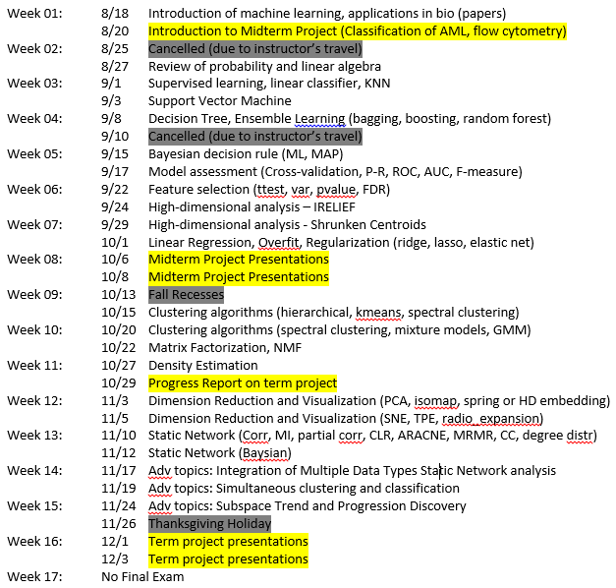
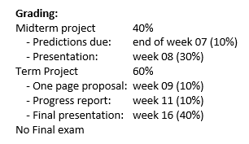
Syllabus

Slide 3
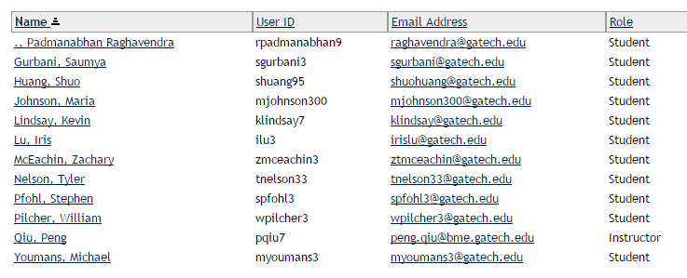
Class attendance

Slide 4
Midterm Project
Classification of AML
The goal of this project is to predict patient’s AML or normal status from patient blood samples profiled by flow cytometry.

Slide 5
Flow cytometry
Flow: what is it?
Evaluate cells in single-cell suspension
Sample is prepared in liquid form
Cells flow in a thin stream (usually saline)
Cells pass a detector one by one.
Cytometry: what does the detector measure?
How much of something exists inside or on the surface of a cell?
Surface protein markers: CD19/20, CD3/4/8, …
Proteins markers inside: pStat3/5, pAKT, …
Size, granularity, DNA content, viability …

Slide 6
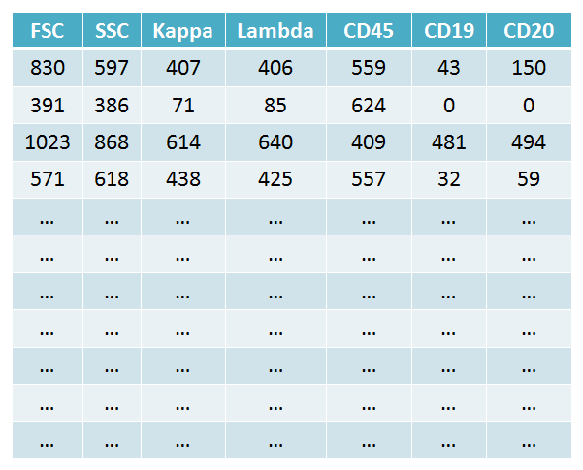
Flow cytometry
Decide what to measure:
'Kappa‘
'Lambda‘
'CD45‘
'CD19‘
'CD20'
PMT 5
'FSC‘
'SSC‘
'FITC‘
'PE‘
‘ECD‘
‘PC5‘
‘PC7‘
PMT 4
Flow chamber
Dichroic
PMT 3
Filters
PMT 2
Sample
Scatter
PMT 1
Laser
(<= 12)
Sensor
Bandpass
Filters

Slide 7
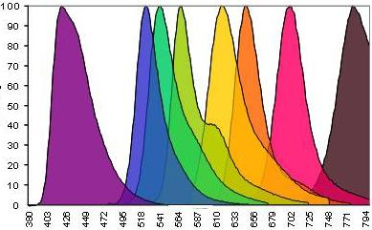
Limitation
Intensity
Wavelength

Slide 8
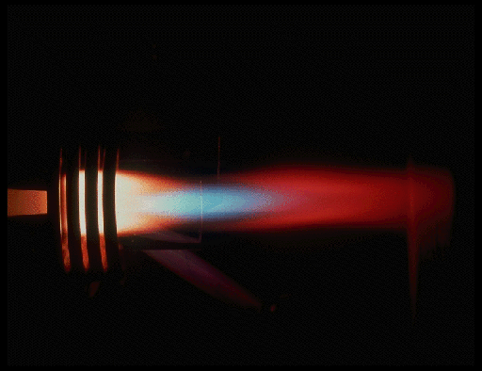
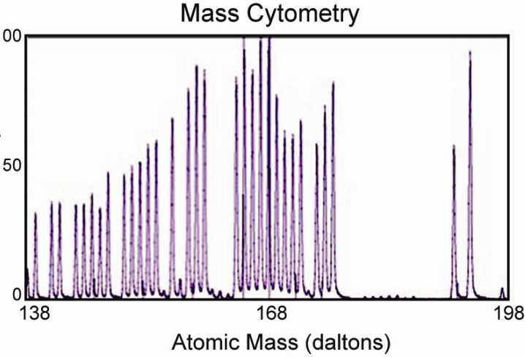
Mass cytometry (CyTOF)
Decide what to measure:
'Kappa‘
'Lambda‘
'CD45‘
'CD19‘
'CD20‘
…
…
…
DNA
Viability
La(138.906)
Nd(144.912)
Nd(145.913)
Eu(150.919)
Gd(155.922)
…
…
…
Flow chamber
Sample
Plasma
torch
Mass Spectrum
Ion Signal
(<= 100)

Slide 9
Flow cytometry data for one sample

Slide 10
Flow cytometry data for one sample
Many many cells
Features

Slide 11
Biology questions
Relationship among cells
Identify cell types
Infer how different cell types are related
Relationship among markers
Identify signaling network
Relationship between cells and overall phenotype
cellular composition of a tumor vs. survival, (drug response, …)
Relationship between markers and overall phenotype
whether a signaling pathway is cell type specific, or disease specific?

Slide 12
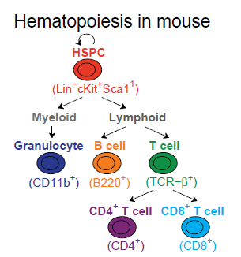
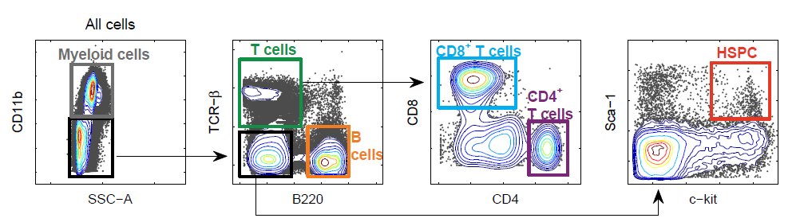
Convention analysis of flow cytometry data
Example data
Flow cytometry
Mouse bone marrow
Parameters: c-kit, Sca-1, CD11b, B220, TCR-b, CD4, CD8
Traditional analysis: Gating
(Kenny, Nolan lab)

Slide 13
Flow cytometry data for one sample

Slide 14
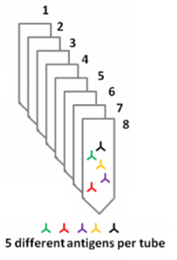
Classification of AML Project
359 subjects
316 normal subjects
43 AML samples
For each subject, one blood sample is taken, and split into 8 tubes.
For each tube, 7 channels are measured
FSC, SSC
5 protein markers
Normal/AML class labels of 179 samples are given
Task: predict the class labels of the remaining 180 samples

Slide 15
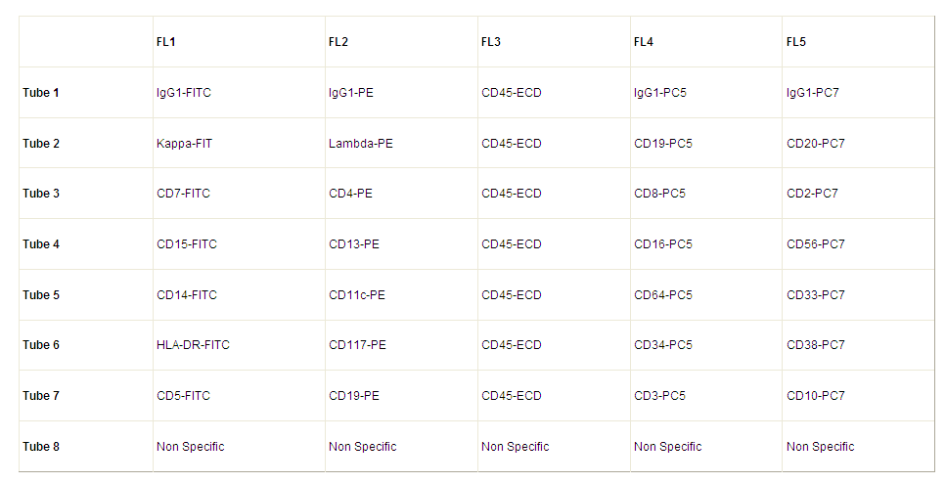
Classification of AML Project

Slide 16
Classification of AML Project
359 subjects
316 normal subjects
43 AML samples
For each subject, one blood sample is taken, and split into 8 tubes.
For each tube, 7 channels are measured
FSC, SSC
5 protein markers
Normal/AML class labels of 179 samples are given
Task: predict the class labels of the remaining 180 samples

Slide 17
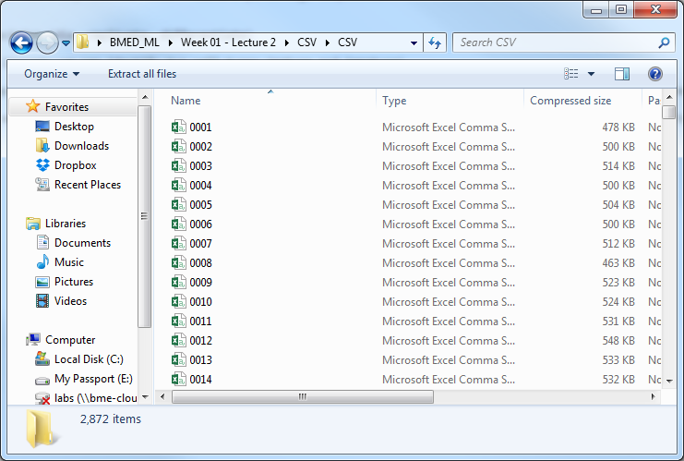
Data
2872 data files in total (359 subjects * 8 tubes)
http://pengqiu.gatech.edu/MLB/CSV.zip

Slide 18
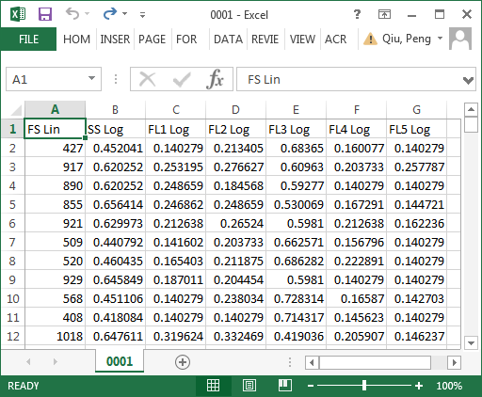
Data
2872 data files in total (359 subjects * 8 tubes)
http://pengqiu.gatech.edu/MLB/CSV.zip

Slide 19
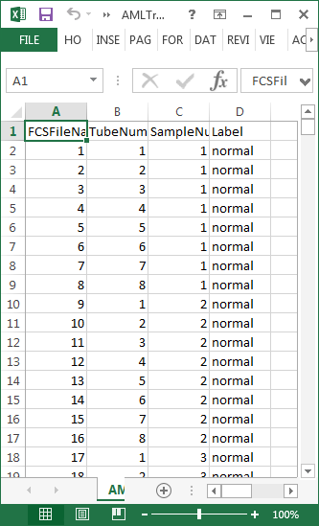
Data
Normal/AML class labels of 179 samples are given
http://pengqiu.gatech.edu/MLB/AMLTraining.csv.zip

Slide 20
Data preprocessing: step 0
>> data = csvread('0001.CSV',1,0);
>> mean(data)
ans =
663.9823 0.5544 0.2052 0.2023 0.5893 0.1818 0.1620
>> std(data)
ans =
218.8498 0.0950 0.0522 0.0487 0.1073 0.0432 0.0261
>>

Slide 21
Data preprocessing: step 0
>> data(:,1) = data(:,1)-mean(data(:,1));
>> data(:,1) = data(:,1)/std(data(:,1))*0.1;
>> mean(data)
ans =
0.0000 0.5544 0.2052 0.2023 0.5893 0.1818 0.1620
>> std(data)
ans =
0.1000 0.0950 0.0522 0.0487 0.1073 0.0432 0.0261
>>

Slide 22
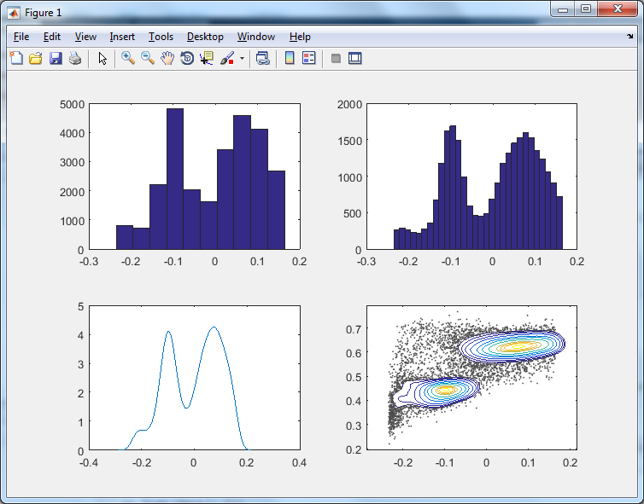
1D and 2D visualization
>> subplot(2,2,1); hist(data(:,1))
>> subplot(2,2,2); hist(data(:,1),30)
>> subplot(2,2,3); ksdensity(data(:,1))
>> subplot(2,2,4); FlowJo_contour2D(data(:,1),data(:,2),10)

Slide 23
More data preprocessing ???
Subject 1:
Subject 2:
… …
… …
… …

Slide 24
Data in supervised setting
179 samples
180 samples
Features
Same features
Training
data
Testing
data
Known labels
???

